Slide 1
Types Of Biological Database
Primary database
NCBI
DDBJ
EMBL
Secondary Database
PDB
GEO
UniProt
Derived database
KEGG
Reactome
NCBI Genome
Literature Databases
PubMed
Embase
BioMed Central

Slide 2


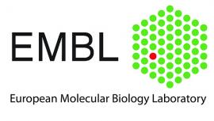

Primary Databases
DDBJ
EMBL
NCBI

Slide 3

NCBI Database
The National Center for Biotechnology Information (NCBI) is a division of the National Library of Medicine (NLM), which is part of the National Institutes of Health (NIH) in the United States. NCBI is a comprehensive resource for biological information, including nucleotide sequences, protein sequences, gene expression data, and structural information.
One of the most well-known databases hosted by NCBI is GenBank, which is a collection of all publicly available nucleotide sequences. NCBI also hosts other important databases, such as PubMed, which provides access to biomedical literature, and the BLAST (Basic Local Alignment Search Tool) suite, which allows researchers to compare sequences against a vast database to find similarities and relationships.
Overall, NCBI plays a critical role in advancing biological and medical research by providing access to a wealth of biological data and tools for analysis and interpretation.

Slide 4
Practical !
Explore NCBI Databases:
Go to the NCBI website (https://www.ncbi.nlm.nih.gov/) and navigate to the "All Databases" tab.
Explore the different databases available, such as PubMed, GenBank, and BLAST.
Click on each database to learn more about its content and purpose.
Retrieve a accession number from GenBank: NP_199756.1
Go to the GenBank database on the NCBI website.
Use the search bar to find a specific gene or organism you are interested in.
Click on a result to view the details of the sequence.
Copy the accession number of the sequence.
Use BLAST to Find Similar Sequences:
Go to the BLAST (Basic Local Alignment Search Tool) page on the NCBI website.
Choose the type of BLAST you want to perform (e.g., BLASTn for nucleotide sequences).
Enter the sequence you retrieved from GenBank or a sequence of your own.
Run the BLAST search and explore the results to find similar sequences.
Download a Sequence from GenBank:
Go back to the GenBank database and enter the accession number of the sequence you found earlier.
Locate the "Send to" option and choose "File" to download the sequence in a format of your choice (e.g., FASTA).

Slide 5

EMBL
Database
The EMBL Nucleotide Sequence Database is a comprehensive database of DNA and RNA sequences collected from the scientific literature and patent applications and directly submitted from researchers and sequencing groups.
Founded: 1974
Headquarters location: Heidelberg, Germany

Slide 6
Practical!
Explore EMBL Databases:
Go to the EMBL-EBI website (https://www.ebi.ac.uk/) and navigate to the "Databases" tab.
Explore the different databases available, such as ENA (European Nucleotide Archive), UniProt, and ArrayExpress.
Click on each database to learn more about its content and purpose.
Retrieve a accession number from ENA: AT2G18160
Go to the ENA database on the EMBL-EBI website.
Use the search bar to find a specific gene or organism you are interested in.
Click on a result to view the details of the sequence.
Copy the accession number of the sequence.
Use the EMBL-EBI Search to Find Similar Sequences:
Go to the EMBL-EBI Search page (https://www.ebi.ac.uk/ebisearch/) on the EMBL-EBI website.
Enter the accession number of the sequence you retrieved from ENA or a sequence of your own.
Run the search and explore the results to find similar sequences.
Download a Sequence from ENA:
Go back to the ENA database and enter the accession number of the sequence you found earlier.
Locate the "Download" option and choose the format in which you want to download the sequence (e.g., FASTA).

Slide 7
DDJB
Database
The DNA Data Bank of Japan is a biological database that collects DNA sequences. It is located at the National Institute of Genetics in the Shizuoka prefecture of Japan. It is also a member of the International Nucleotide Sequence Database Collaboration or INSDC.
Founded: 1986
Headquarters location: Mishima, Shizuoka, Japan

Slide 8
Practical !
Explore DDBJ Databases:
Go to the DDBJ website (https://www.ddbj.nig.ac.jp/) and navigate to the "Search" or "Database" section.
Explore the different databases available, such as DDBJ Sequence Read Archive (DRA), DDBJ BioProject, and DDBJ Sequence Database.
Click on each database to learn more about its content and purpose.
Retrieve a Sequence from DDBJ Sequence Database: OP921973
Go to the DDBJ Sequence Database on the DDBJ website.
Use the search bar to find a specific gene or sequence you are interested in.
Click on a result to view the details of the sequence.
Copy the accession number of the sequence.
Use DDBJ's Search Tools to Find Similar Sequences:
Go to the DDBJ Search page (https://www.ddbj.nig.ac.jp/searches-e.html) on the DDBJ website.
Enter the accession number of the sequence you retrieved from the DDBJ Sequence Database or a sequence of your own.
Run the search and explore the results to find similar sequences.
Explore DDBJ BioProject for Project Information:
Go to the DDBJ BioProject database on the DDBJ website.
Use the search bar to find information about a specific project or study.
Explore the search results and click on a project entry to view its details.
Download a Sequence from DDBJ:
Go back to the DDBJ Sequence Database and enter the accession number of the sequence you found earlier.
Locate the "Download" option and choose the format in which you want to download the sequence (e.g., FASTA).

Slide 9
Secondary Databases
Databases that store information about protein structures, such as the Protein Data Bank (PDB), which contains experimentally determined structures of proteins, nucleic acids, and complex assemblies.
They often provide curated, annotated, and specialized information that is useful for specific types of analyses or research questions.
Databases that store information about drugs and their targets, such as DrugBank, which provides information about drug targets, pharmacology, and drug interactions.
Secondary databases in bioinformatics are databases that contain derived or processed data from primary sources, such as primary sequence databases
ClinVar

Slide 10
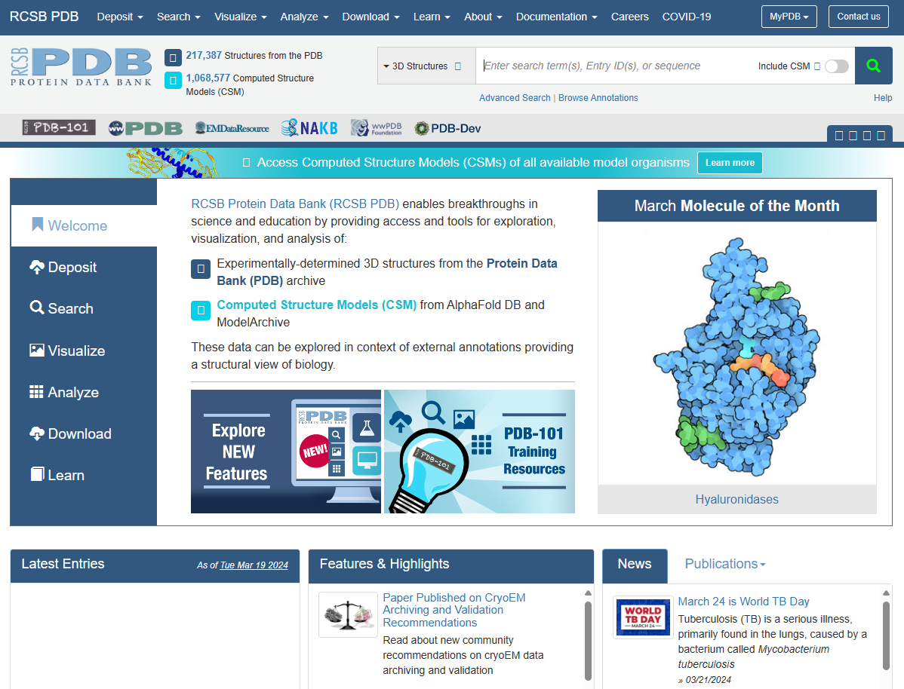
PDB
The Protein Data Bank (PDB) is a comprehensive, worldwide repository of 3D structural data of biological macromolecules, such as proteins, nucleic acids, and complex assemblies. It provides a wealth of information about the shapes and structures of these molecules, which is crucial for understanding their functions and interactions.
The PDB contains experimentally determined structures obtained through techniques like X-ray crystallography, NMR spectroscopy, and cryo-electron microscopy. Researchers and scientists from around the globe use the PDB to study the structures of biomolecules, develop new drugs, and advance our understanding of biology and medicine.

Slide 11
Practical !
Explore PDB Databases:
Go to the PDB website (https://www.rcsb.org/) and navigate to the "Explore" or "Search" section.
Explore the different databases available, such as PDB-101, RCSB PDB, and EMDB (Electron Microscopy Data Bank).
Click on each database to learn more about its content and purpose.
Search for a Protein Structure:
Use the search bar on the PDB website to find a specific protein structure.
Enter the name of a protein or a keyword related to a protein structure you are interested in.
Explore the search results and click on a protein structure entry to view its details.
View a Protein Structure:
Select a protein structure from the search results to view its 3D structure.
Use the tools provided on the PDB website to visualize the protein structure in different ways (e.g., ribbon, cartoon, or surface representation).
Download a Protein Structure:
Once you have found a protein structure you are interested in, locate the "Download" or "Download Files" option.
Choose the format in which you want to download the protein structure file (e.g., PDB format).
Explore PDB-101 for Educational Resources:
Go to the PDB-101 website (https://pdb101.rcsb.org/) to access educational resources related to protein structures.
Explore the different sections of the website, such as Molecule of the Month and Structural View of Biology, to learn more about protein structures and their functions.

Slide 12
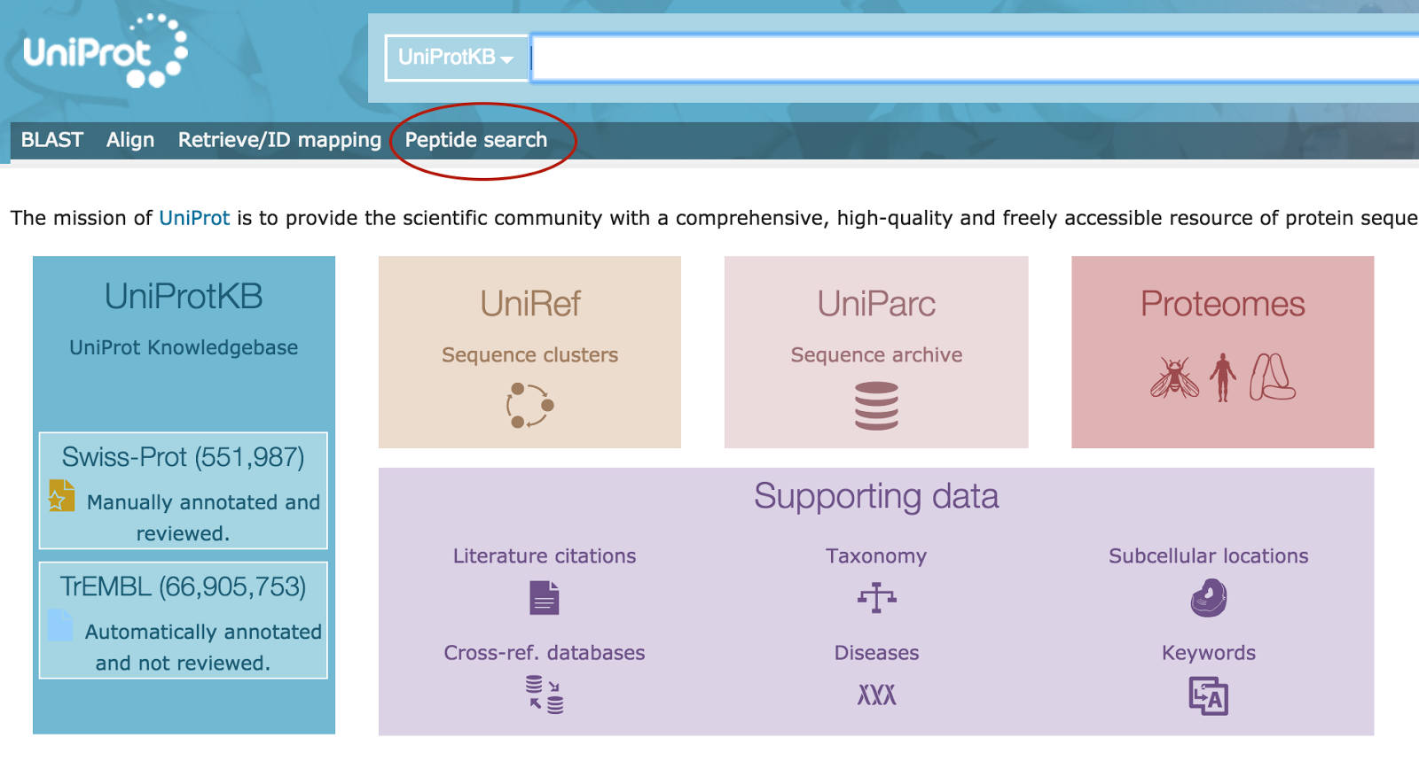
UniProt
This is a protein sequence database that provides a high level of integration with other databases and also has a very low level of redundancy (means less identical sequences are present in the database).

Slide 13
Practical !
Explore UniProt Databases:
Go to the UniProt website (https://www.uniprot.org/) and navigate to the "Database" section.
Explore the different databases available, such as UniProtKB (Knowledgebase), UniRef (Reference Clusters), and UniParc (Proteomes Archive).
Click on each database to learn more about its content and purpose.
Search for a Protein: INSR
Use the search bar on the UniProt website to find information about a specific protein.
Enter the name of a protein or a keyword related to a protein you are interested in.
Explore the search results and click on a protein entry to view its details.
View Protein Information:
Select a protein from the search results to view its detailed information.
Explore the protein's function, structure, interactions, and other relevant information provided in the UniProt entry.
Download Protein Information:
Once you have found a protein entry you are interested in, locate the "Download" or "Download Entry" option.
Choose the format in which you want to download the protein information (e.g., text, XML, or FASTA format).
Explore UniProt Annotations and Features:
Select a protein entry and explore the annotations and features provided in the UniProt entry.
Look for information such as protein domains, post-translational modifications, and subcellular localization.

Slide 14
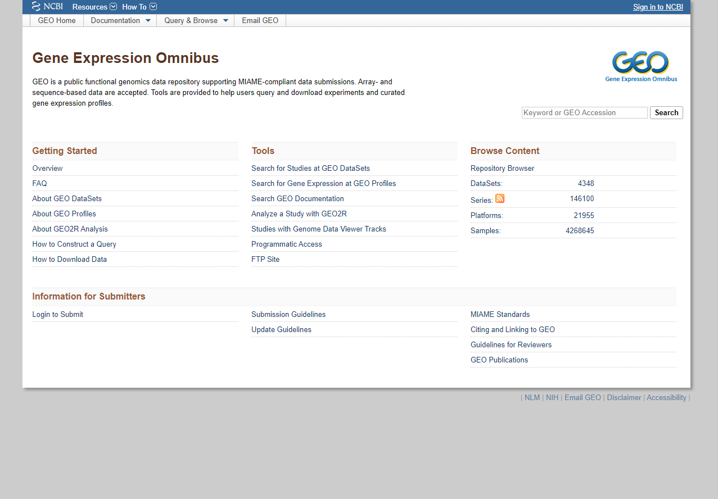
GEO
GEO is a public functional genomics data repository supporting MIAME-compliant data submissions. Array- and sequence-based data are accepted.

Slide 15
Practical !
Explore GEO Databases:
Go to the GEO website (https://www.ncbi.nlm.nih.gov/geo/) and navigate to the "DataSets" or "Search" section.
Explore the different datasets available, such as gene expression profiles, microarray data, and RNA-seq data.
Click on each dataset to learn more about its content and purpose.
Search for Gene Expression Data: GSE249262
Use the search bar on the GEO website to find gene expression data related to a specific gene or biological process.
Enter the name of a gene or a keyword related to a biological process you are interested in.
Explore the search results and click on a dataset entry to view its details.
View Gene Expression Profiles:
Select a dataset from the search results to view its gene expression profiles.
Explore the gene expression levels across different samples or conditions in the dataset.
Download Gene Expression Data:
Once you have found a dataset you are interested in, locate the "Download" or "Accession" option.
Choose the format in which you want to download the gene expression data (e.g., TXT, CSV, or GEO Series Matrix).
Explore GEO Series and Platforms:
Explore the GEO Series and Platforms sections on the GEO website to learn more about the datasets and platforms used in gene expression studies.
Click on each entry to view its details and explore related datasets.
Use GEO2R for Differential Gene Expression Analysis: !!!!!!
Explore the GEO2R tool on the GEO website for differential gene expression analysis.
Select a dataset and use GEO2R to compare gene expression levels between different samples or conditions.

Slide 16
Comparison
Primary databases
VS
Secondary databases
Contains original data from the researchers
I
I
Results from entries of primary database
Public or open access mostly
II
II
Manually created or automatically created
NCBI, EMBL,DDBJ
III
III
PDB, UniProt, GEO

Slide 17
Derived Database
Derived databases often include annotations, such as functional annotations (e.g., gene ontology, structural annotations
Derived databases provide processed or curated information based on the data in the primary databases.
Derived databases in bioinformatics are databases that are created or derived from primary databases.

Slide 18

Genome
Genome Contains sequence and map data from the whole genomes of over 1000 organisms. The genomes represent both completely sequenced organisms and those for which sequencing is in progress.

Slide 19
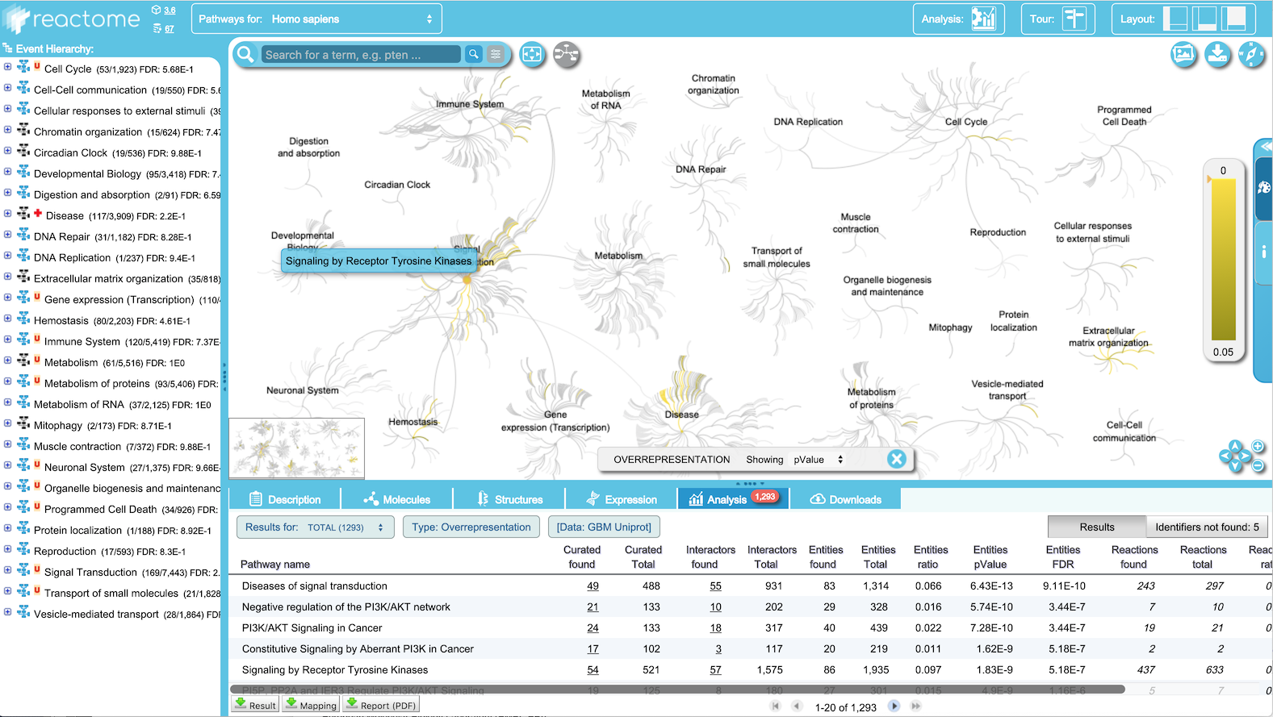
REACTOME
REACTOME is an open-source, open access, manually curated and peer-reviewed pathway database. Goal is to provide intuitive bioinformatics tools for the visualization, interpretation and analysis of pathway knowledge to support basic and clinical research, genome analysis, modeling, systems biology and education.

Slide 20
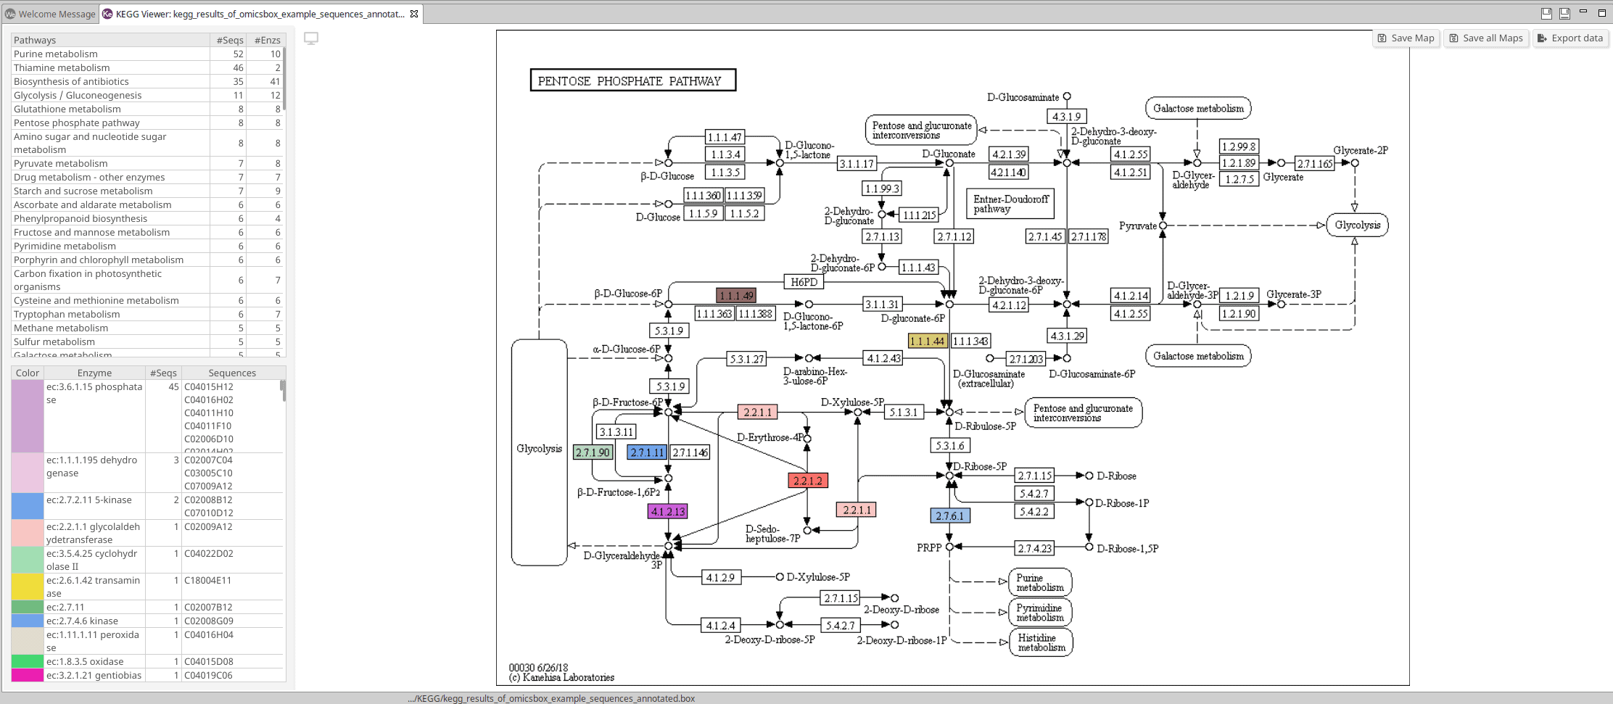
KEGG
KEGG is a database resource for understanding high-level functions and utilities of the biological system, such as the cell, the organism and the ecosystem, from molecular-level information, especially large-scale molecular datasets generated by genome sequencing and other high-throughput experimental technologies.

Slide 21
Practical !
Explore Genome Database:
Go to the Genome website (https://www.ncbi.nlm.nih.gov/genome/) and navigate to the "Search" or "Database" section.
Explore the NCBI Genome database and search for human genome.
Click on database to learn more about its content and purpose
Explore Reactome Database:
Go to the Reactome website (https://reactome.org/) and navigate to the "Search" or "Database" section.
Explore the Reactome database and search for any pathway.
Click on database to learn more about its content and purpose
Explore KEGG Database:
Go to the KEGG website (https://www.genome.jp/kegg/) and navigate to the "Search" or "Database" section.
Explore the KEGG database and search for any pathway.
Click on database to learn more about its content and purpose

Slide 22
Additional Literature Databases For Bioinformatics
Databases
Embase
PubMed
PubMed Central and publisher web sites
Embase is a versatile and up-to-date biomedical research database
ScienceDirect
Science Direct is the web site for selected journal titles
BioMed Central
BMC has an evolving portfolio.

Slide 23
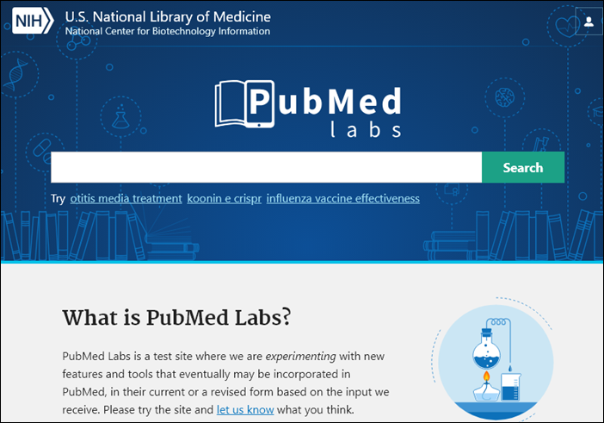
PubMed
PubMed comprises more than 29 million citations for biomedical literature from MEDLINE, life science journals, and online books. Citations may include links to full-text content from PubMed Central and publisher web sites. For tips on searching efficiently and effectively in PubMed.

Slide 24

Embase
Embase is a versatile and up-to-date biomedical research database covering the most important international biomedical literature from 1947 to the present day with more than 32+ million records from 8,200 journals and ‘grey literature’ from over 2.4 million conference abstracts.

Slide 25
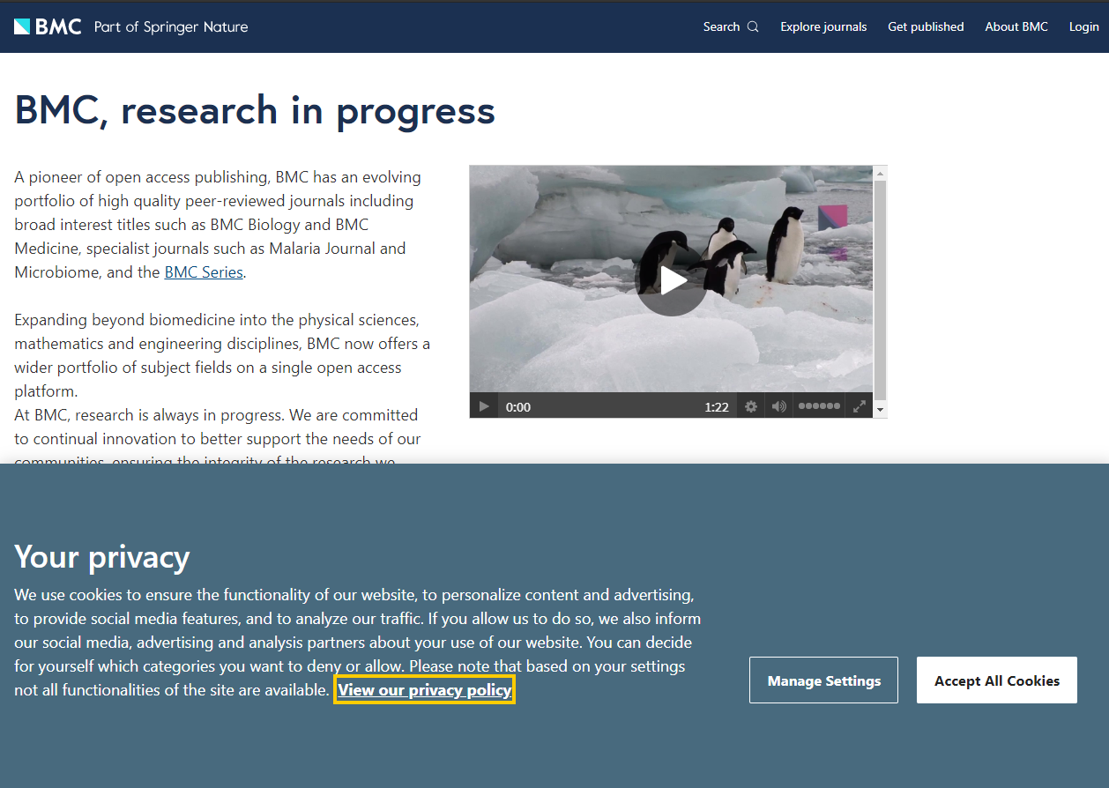
BioMed Central
BMC has an evolving portfolio of some 300 peer-reviewed, open access journals, sharing discoveries from research communities in science, technology, engineering and medicine.

Slide 26
Practical !
1. Explore PubMed for Research Articles:
Go to the PubMed database on the NCBI website.
Use the search bar to find research articles related to a specific topic or gene.
Explore the search results and click on an article to view its details.
Explore Embase for Research Articles:
Go to the BioMed Central database on the NCBI website.
Use the search bar to find research articles related to a specific topic or gene.
Explore the search results and click on an article to view its details.
Explore BioMed Central for Research Articles:
Go to the BioMed Central database on the NCBI website.
Use the search bar to find research articles related to a specific topic or gene.
Explore the search results and click on an article to view its details.

